Slide 1


Computational Intelligence (TC2023)

Slide 2
Unit IV –Network Traffic Analysis (2)
Outline
NSL-KDD Dataset
Principal Component Analysis
K-means Clustering
Clustering Metrics

Slide 3

NSL-KDD Dataset

Slide 4

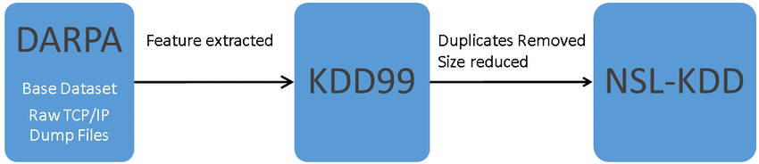
NSL-KDD Dataset
The dataset that we will use is the NSLKDD dataset,22 which is an improvement to a classic network intrusion detection dataset used widely by security data science professionals.
The original 1999 KDD Cup dataset was created for the DARPA Intrusion Detection Evaluation Program, prepared and managed by MIT Lincoln Laboratory.

Slide 5
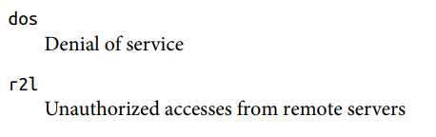
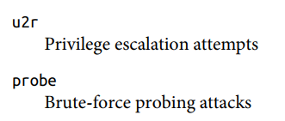
NSL-KDD Dataset
General Attacks Categories
The data was collected over nine weeks and consists of raw tcpdump traffic in a local area network (LAN) that simulates the environment of a typical United States Air Force LAN.
Some network attacks were deliberately carried out during the recording period.
There were 38 different types of attacks, but only 24 are available in the training set.

Slide 6
NSL-KDD Dataset
General Attacks Categories

Slide 7
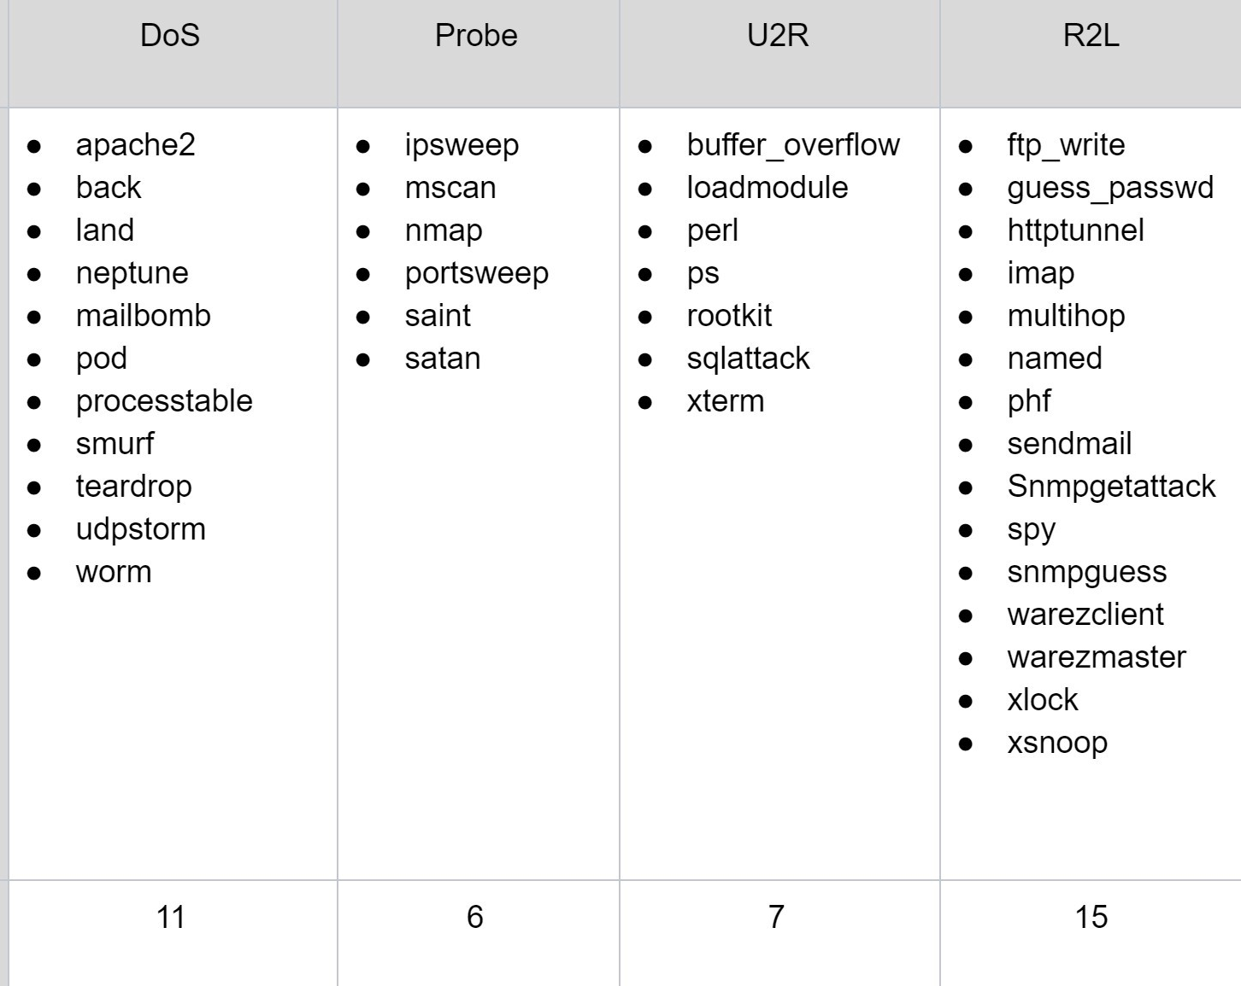
NSL-KDD Dataset

Slide 8
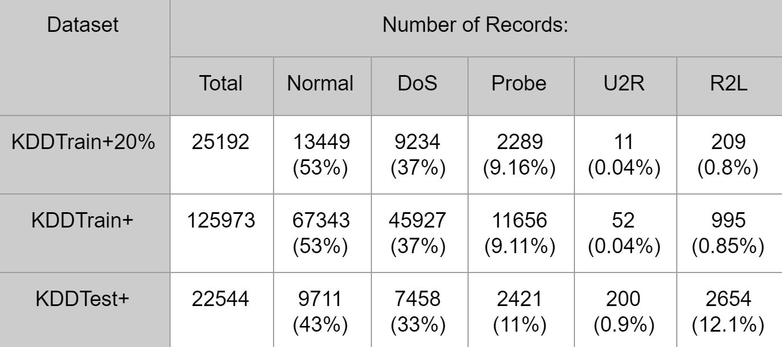
NSL-KDD Dataset

Slide 9
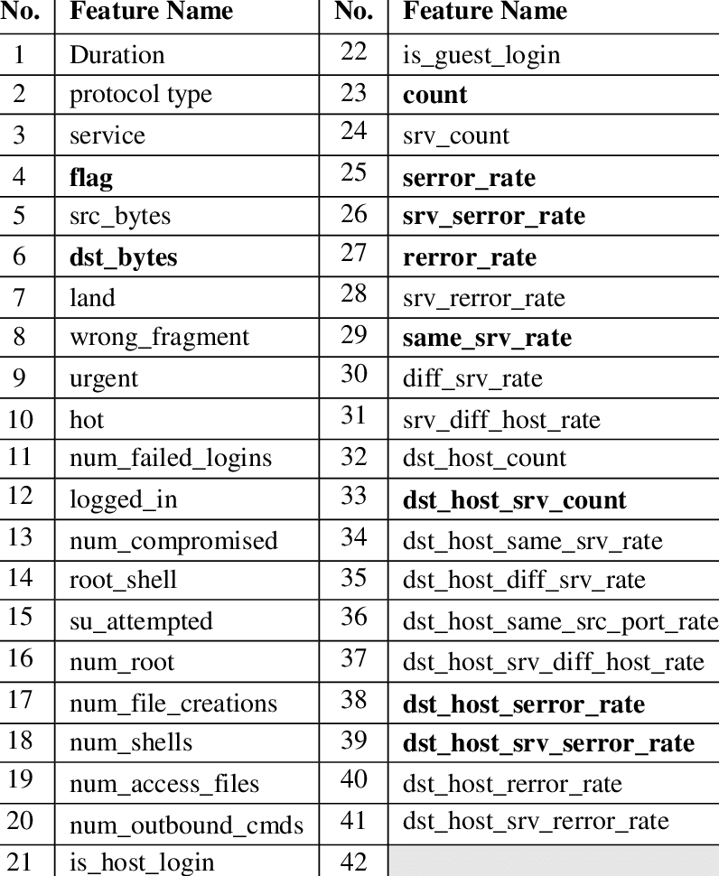
NSL-KDD Dataset

Slide 10
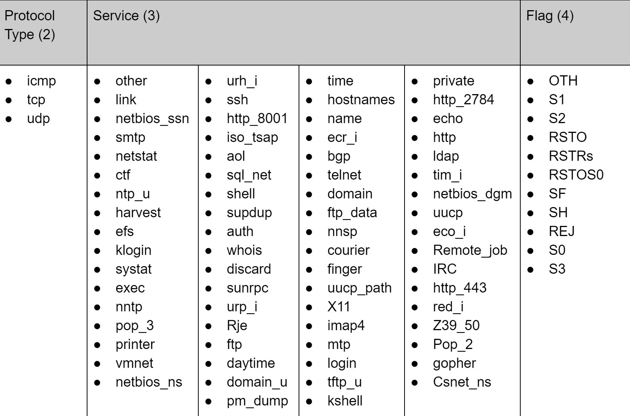

Slide 11
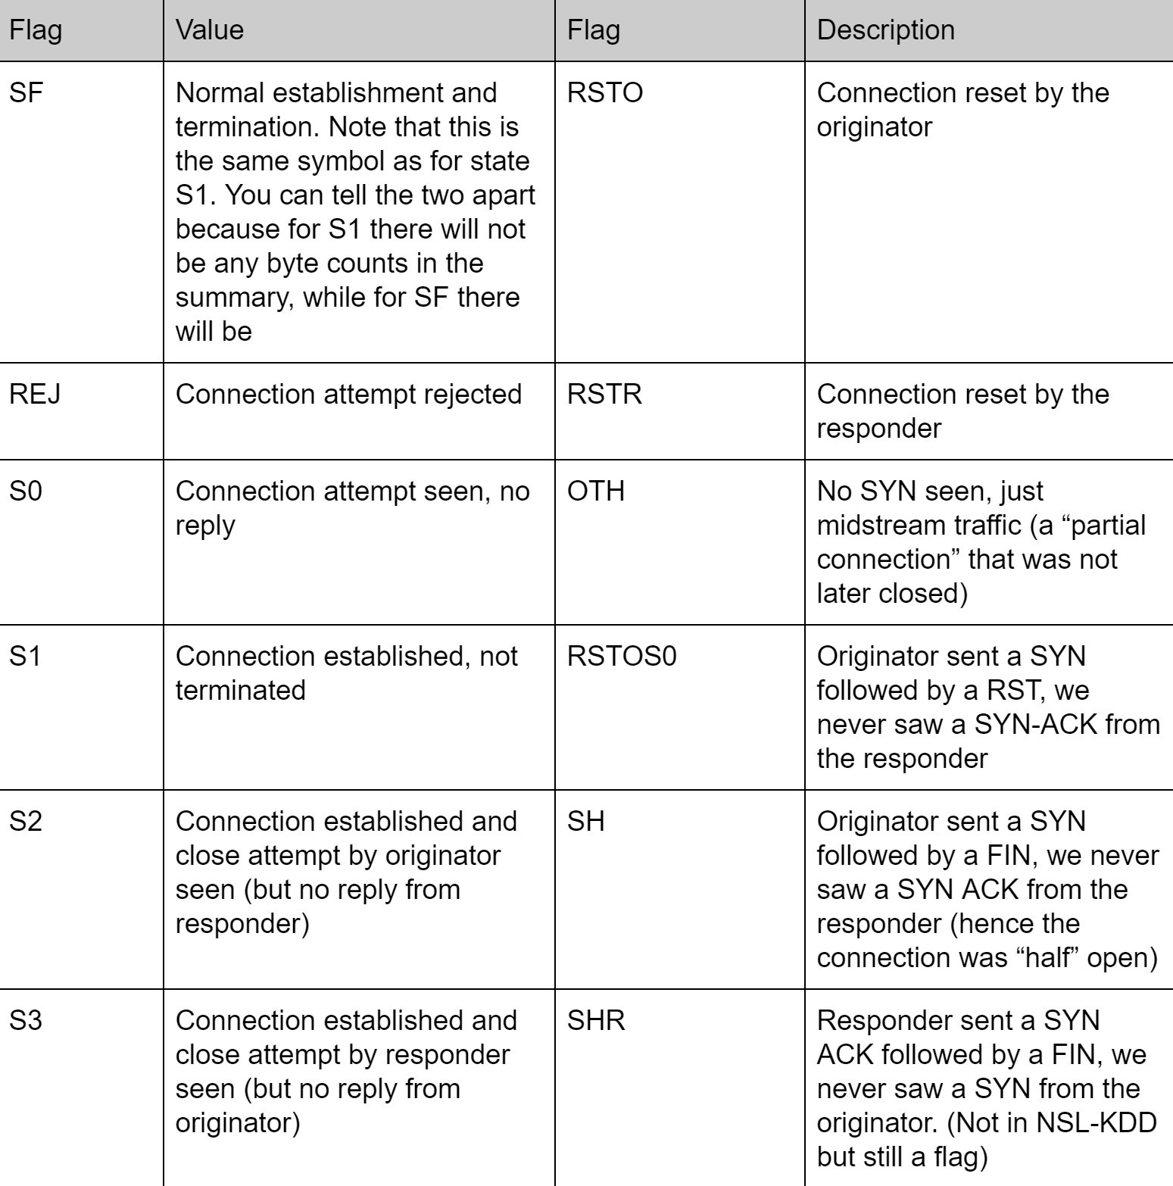
NSL-KDD Dataset

Slide 12
Principal Component Analysis

Slide 13
Principal Component Analysis (PCA)
PCA is a method of dimensionality reduction, feature extraction that transforms the data from “d-dimensional space” into a new coordinate system of dimension p , where p <= d.
ML models with many input variables or higher dimensionality tend to fail when operating on a higher input dataset.
PCA helps in identifying relationships among different variables & then coupling them. PCA involves the transformation of variables in the dataset into a new set of variables which are called PCs (Principal Components).

Slide 14
PCA Transformations
In order to approximate the space spanned by the original data points (X=[x1,x2x3,……….,xd]), we can choose p based on what percentage of the variance of the original data we would lie to maintain .
The first principal component (PC) has the maximum variance; thus, it accounts for the most significant variance in data.
The Second PC has the second highest variance and so on until principal component has minimum variance.

Slide 15
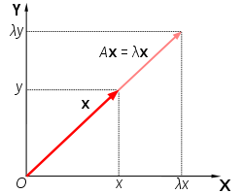
Eigenvalues and eigenvectors
In linear algebra, an eigenvector of a linear transformation is a nonzero vector that changes at most by a scalar factor when that linear transformation is applied to it.
The corresponding eigenvalue, often denoted by λ, is the factor by which the eigenvector is scaled.
Matrix A acts by stretching the vector x, not changing its direction, so x is an eigenvector of A.

Slide 16
PCA Method
Standardize the data.
Perform Singular Vector Decomposition to get the Eigenvectors and Eigenvalues.
Sort eigenvalues in descending order and choose the k- eigenvectors
Construct the projection matrix from the selected k- eigenvectors.
Transform the original dataset via projection matrix to obtain a k-dimensional feature subspace.
Notes:
In linear algebra, an eigenvector (/ˈaɪɡənˌvɛktər/) or characteristic vector of a linear transformation is a nonzero vector that changes at most by a scalar factor when that linear transformation is applied to it. The corresponding eigenvalue, often denoted by {\displaystyle \lambda },^{[1]} is the factor by which the eigenvector is scaled.

Slide 17
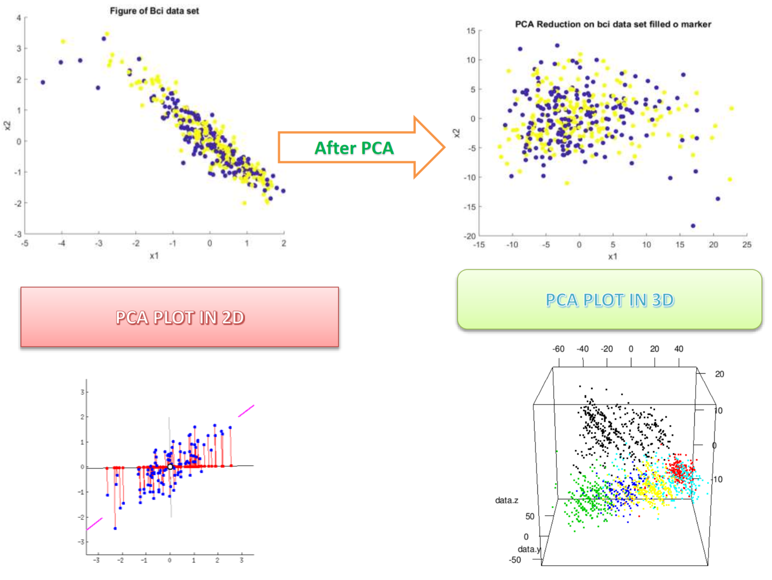
PCA Method
Notes:
In linear algebra, an eigenvector (/ˈaɪɡənˌvɛktər/) or characteristic vector of a linear transformation is a nonzero vector that changes at most by a scalar factor when that linear transformation is applied to it. The corresponding eigenvalue, often denoted by {\displaystyle \lambda },^{[1]} is the factor by which the eigenvector is scaled.

Slide 18
K-means Clustering

Slide 19
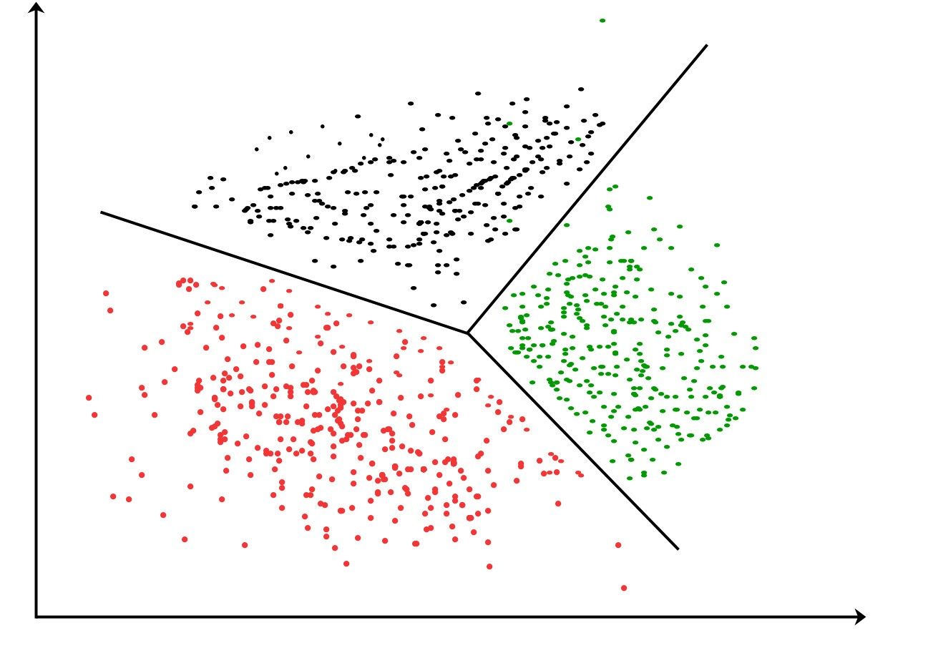
What is a clustering?
Finding “natural” groupings between objects
We want to find similar objects (f.e. documents) to treat them in the same way

Slide 20
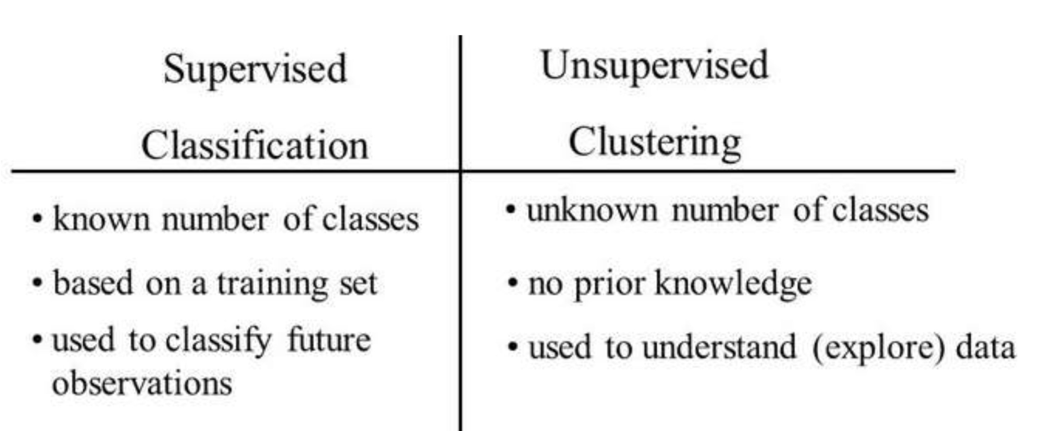
Cluster is unsupervised method

Slide 21
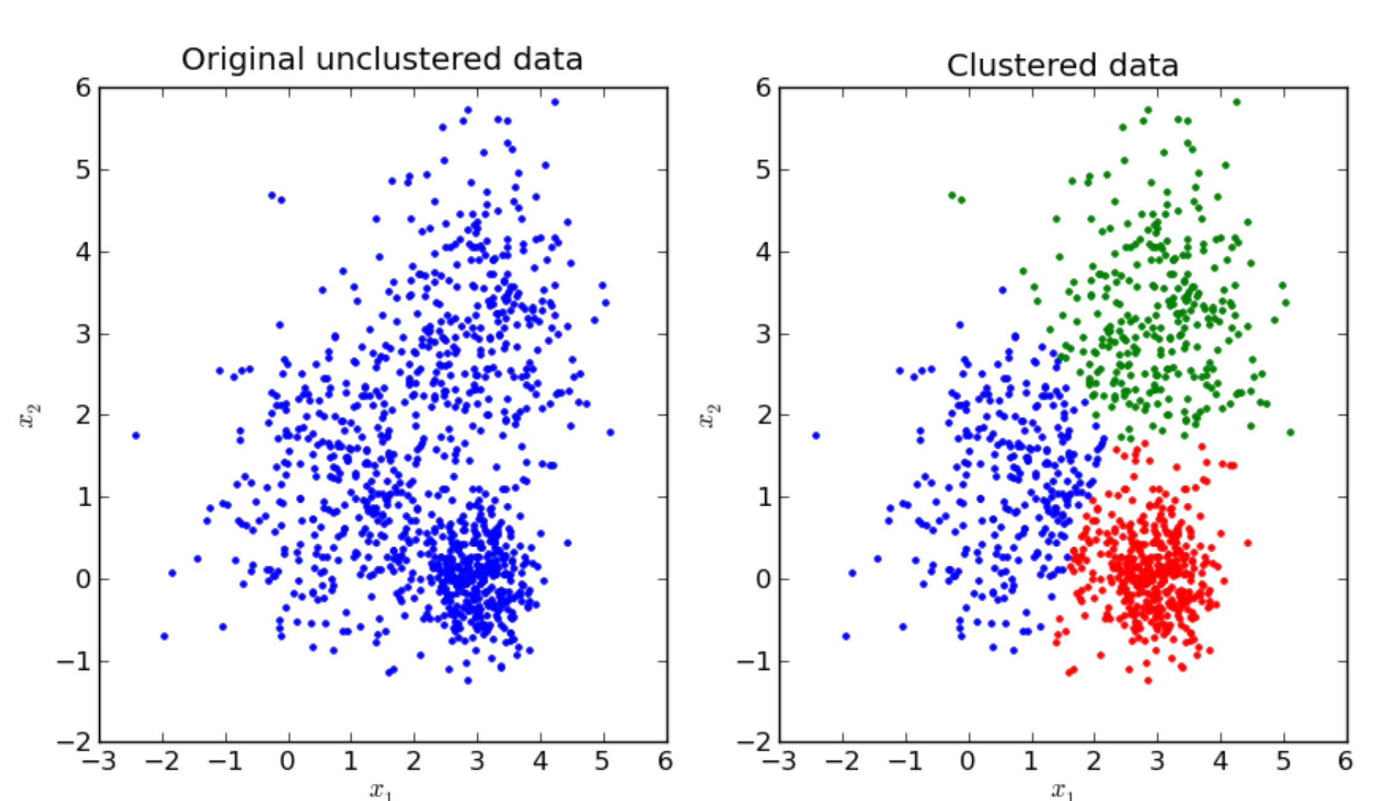
What is a k-means clustering?
K-means clustering aims to partition n observations into k clusters in which each observation belongs to the cluster with the nearest mean.

Slide 22
How do we measure similarity?
Similarity is subjective
Its measure therefore depends on the data, the use case, the users
In practice it is not always straightforward which metrics work well - then “trial and error” can be followed

Slide 23
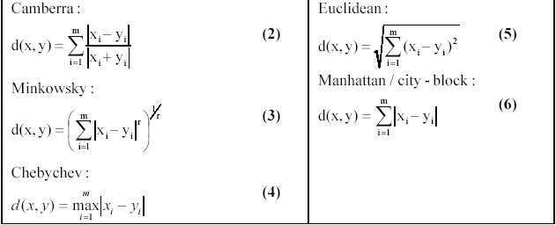
Examples of similarity measures

Slide 24
K-Means Clustering
Strengths
Simple iterative method
User provides “K”
Weaknesses
Often too simple -> bad results
Difficult to guess the correct “K”

Slide 25
K-Means Clustering
Step 0: select K
Step 1: randomly select initial cluster seeds
Seed 1 650
Seed 2 200
An initial cluster seed represents the “mean value” of its cluster.

Slide 26
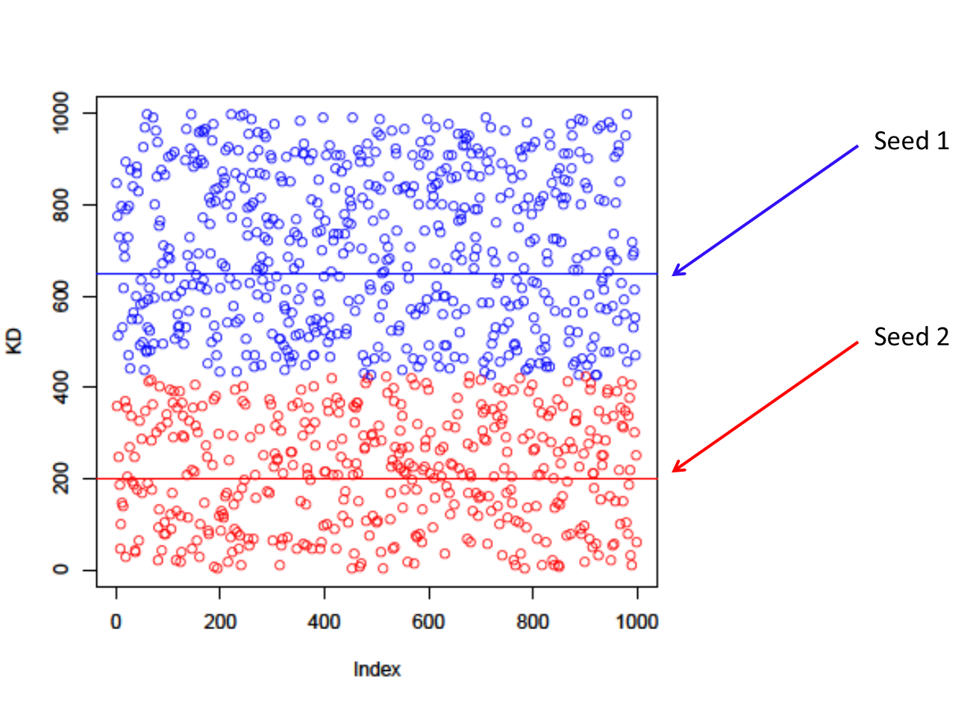
K-Means Clustering
Step 2: calculate distance from each object to each cluster seed.
What type of distance should we use?
Squared Euclidean distance
Step 3: Assign each object to the closest cluster

Slide 27
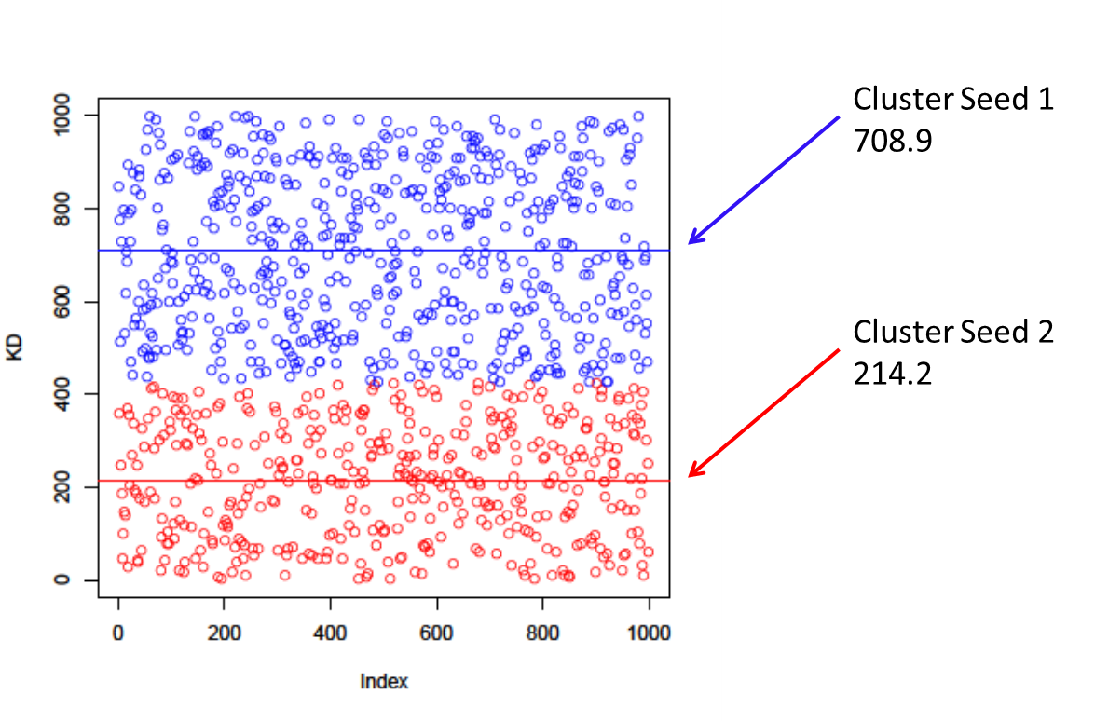
K-Means Clustering
Step 4: Compute the new centroid for each cluster

Slide 28
K-Means Clustering
Iterate:
Calculate distance from objects to cluster centroids.
Assign objects to closest cluster
Recalculate new centroids
Stop based on convergence criteria
No change in clusters
Max iterations

Slide 29
Clustering Metrics

Slide 30
Silhouette Coefficient
The Silhouette Coefficient is calculated using the mean intra-cluster distance (a) and the mean nearest-cluster distance (b) for each sample.
The Silhouette Coefficient for a sample is (b - a) / max(a, b).
The best value is 1 and the worst value is -1. Values near 0 indicate overlapping clusters. Negative values generally indicate that a sample has been assigned to the wrong cluster, as a different cluster is more similar.

Slide 31
Rand Index
The Rand Index computes a similarity measure between two clustering's by considering all pairs of samples and counting pairs that are assigned in the same or different clusters in the predicted and true clustering's.
The raw RI score is then “adjusted for chance” into the ARI score using the following scheme: ARI = (RI - Expected_RI) / (max(RI) - Expected_RI).
The adjusted Rand index is thus ensured to have a value close to 0.0 for random labeling independently of the number of clusters and samples and exactly 1.0 when the clustering's are identical.

Slide 32
K-Means Metrics
Homogeneity: It estimates how many of the clusters predicted contain only members of a single class.
Completeness: measures whether all members of a given class are assigned to the same cluster.
Validity-Measure (V-Measure): is the harmonic mean of homogeneity and completeness.
All scores have positive values between 0.0 and 1.0, larger values being desirable.

Slide 33
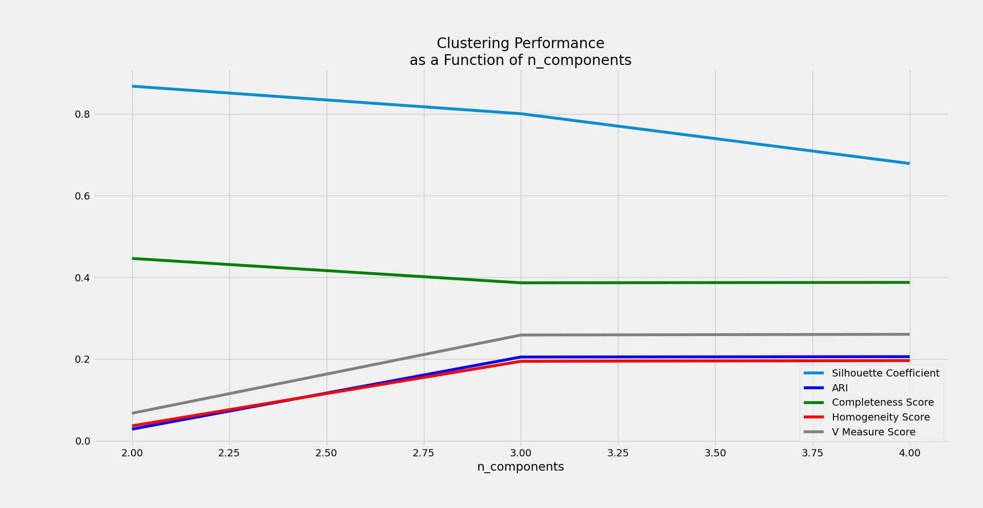

Slide 34
Unit IV –Network Traffic Analysis (2)
Outline
NSL-KDD Dataset
Principal Component Analysis
K-means Clustering
Clustering Metrics

Slide 35
Computational Intelligence (TC2023)

